Slide 1

XML Extensible Markup Language

Slide 2
Presented by
Arthi Lakshmi
Lavanya
Janani
Karthika

Slide 3

What is Data representation Format?
Data representation format determines how data is organized, stored, and interpreted by computers and other devices.
There are several commonly used data representation formats, including:
Text-based Formats : Represent data using human-readable characters.
Plain text files (ASCII or Unicode-encoded), markup languages like HTML or XML, and structured text formats like JSON (JavaScript Object Notation) or YAML (YAML Ain't Markup Language)
Binary Formats: These formats represent data using sequences of bits (0s and 1s)
E.G JPEG,MP3,AVI and executable files
Tabular Formats: Tabular formats organize data in rows and columns, like a spreadsheet.
Examples include CSV (Comma-Separated Values) files and Excel spreadsheets (XLS or XLSX)
Hierarchical Formats: These formats organize data in a hierarchical structure, often represented as a tree-like structure. One popular hierarchical format is XML (eXtensible Markup Language).
Relational Formats: Relational formats organize data into tables with relationships between them.
E.G SQL

Slide 4

What is XML?
XML stands for Extensible Markup Language and is a text-based markup language derived from Standard Generalized Markup Language (SGML).
Important characteristics of XML
XML is extensible
XML carries the data, does not present it
XML is a public standard

Slide 5

XML - Syntax

Slide 6
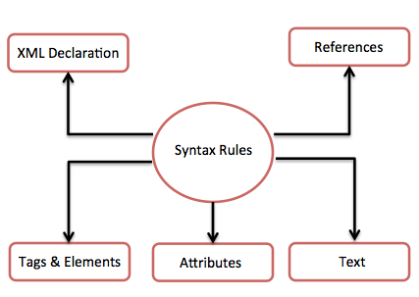

Slide 7
XML - Declaration
<?xml version = "1.0" encoding = "UTF-8"? standalone = “no”>
The XML declaration is case sensitive.
The XML declaration is optional.
It must contain version number attribute.
The Parameter names and values are case-sensitive.
The names are always in lower case.
The order of placing the parameters is important.
The XML declaration has no closing tag i.e., </?xml>

Slide 8
XML – Tags
The beginning of every non-empty XML element is marked by a start-tag. Following is an example of start-tag −
<address>
Every element that has a start tag should end with an end-tag. Following is an example of end-tag −
</address>
An element which has no content is termed as empty.
A start-tag immediately followed by an end-tag as shown here− <hr></hr>
Start Tag
End Tag
Empty Tag

Slide 9

XML – TAGS | Rules
Rule 1
XML tags are case-sensitive.
Wrong way - <address>This is wrong syntax</Address>
Correct way - <address>This is correct syntax</address>
Rule 2
XML tags must be closed in an appropriate order.
For example −
<element1>
<element2> This tag is closed before the outer_element </element2>
</element1>

Slide 10
XML - Elements
XML elements can be defined as building blocks of an XML. Elements can behave as containers to hold text, elements, attributes, media objects
Example XML document using various XML element
<?xml version = "1.0"?>
<contact-info>
<address category = "residence">
<name>Tanmay Patil</name>
<company>TutorialsPoint</company>
<phone>(011) 123-4567</phone>
</address> </contact-info>
Syntax to write an XML Element
<element-name attribute1 attribute2>
....content
</element-name>

Slide 11
XML – Elements | Rules
An element name can contain any alphanumeric characters.
Names are case sensitive. For example, Address, address, and ADDRESS are different names.
Start and end tags of an element must be identical

Slide 12
XML - Attributes
An attribute specifies a single property for the element, using a name/value pair. An XML-element can have one or more attributes. For example −
<a href = "http://www.tutorialspoint.com/">Tutorialspoint!</a>
Here href is the attribute name and http://www.tutorialspoint.com/ is attribute value.

Slide 13
XML – Attributes | Rules
Attribute names in XML are case sensitive.
HREF and href are considered two different XML attributes.
Same attribute cannot have two values in a syntax.
Incorrect syntax because the attribute b is specified twice
Attribute names are defined without quotation marks, whereas attribute values must always appear in quotation marks.
Incorrect xml syntax
<a b = "x" c = "y" b = "z">....</a>
<a b = x>....</a>

Slide 14

XML - Reference
References usually allow you to add or include additional text or markup in an XML document.
Entity References − An entity reference contains a name between the start and the end delimiters. For example, &amp; where amp is name.
Character References - A hash mark (“#”) followed by a number &#38;. 38 refers to “amp(&)”.

Slide 15
XML – Text
Not Allowed Character | Replacement Entity | Character Description
< | &lt; | less than
> | &gt; | greater than
& | &amp; | ampersand
' | &apos; | apostrophe
" | &quot; | quotation mark
Blanks, tabs and line-breaks will be ignored.
Some characters are reserved by the XML syntax itself and they cannot be used directly.

Slide 16

XML - Comment
Any text between <!-- and --> characters is considered as a comment.
Following rules should be followed for XML comments −
It cannot appear before XML declaration.
It may appear anywhere in a document.
It must not appear within attribute values.
It cannot be nested inside the other comments.
<!--Your comment-->

Slide 17
XML - CDATA
<![CDATA[
characters with markup
]]>
By using CDATA section, you are commanding the parser that, the particular section of the document contains no markup and should be treated as regular text.
The above syntax is composed of three sections −
CDATA Start section - <![CDATA[
CDATA End section − ]]> .
CData section − Characters between these two enclosures are interpreted as characters, and not as markup.

Slide 18


Slide 19
Features and Advantages of XML
XML simplifies data sharing.
Platform and language independence.
XML used for data exchange.
Data validation.
Transformation and Processing.

Slide 20

XML file AS Test Data, Config File, Data for Exchange API

Slide 21
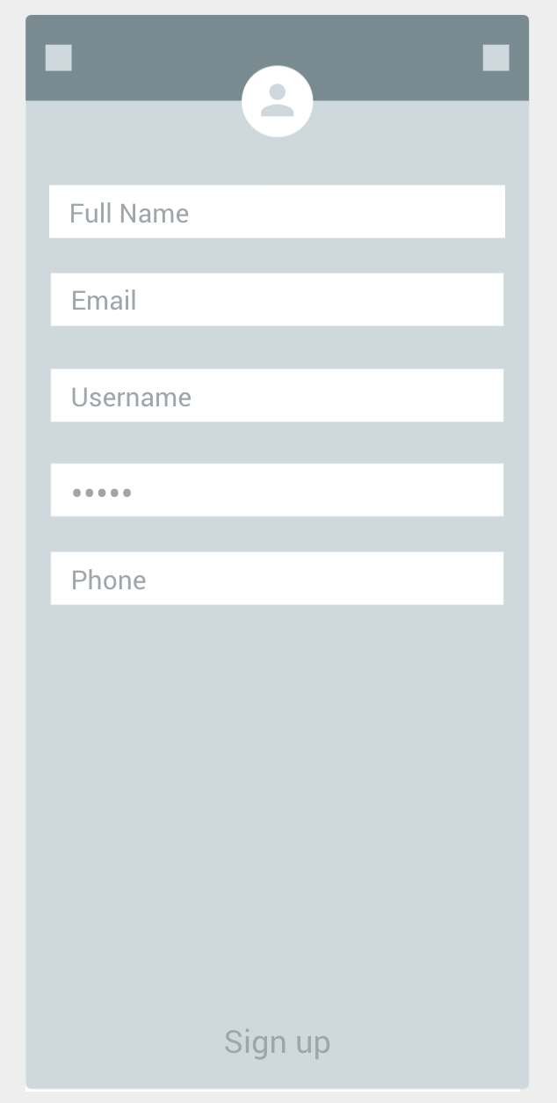
XML File as Test Data – Automation Script
XML file can be used as Test Data for Automation Scripts.

Slide 22
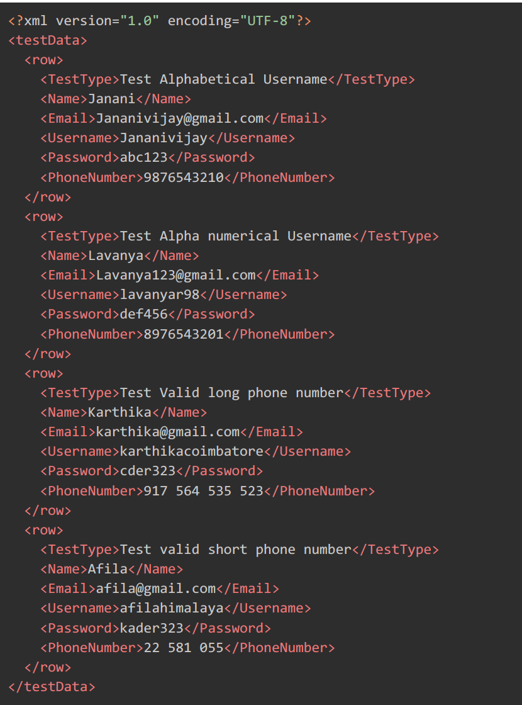
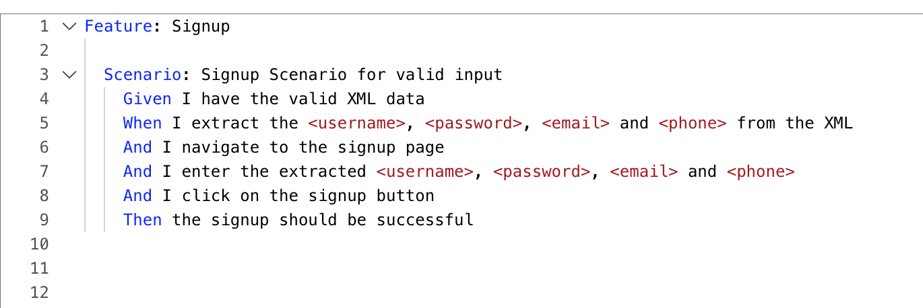
Cucumber- automation test script - valid scenario

Slide 23
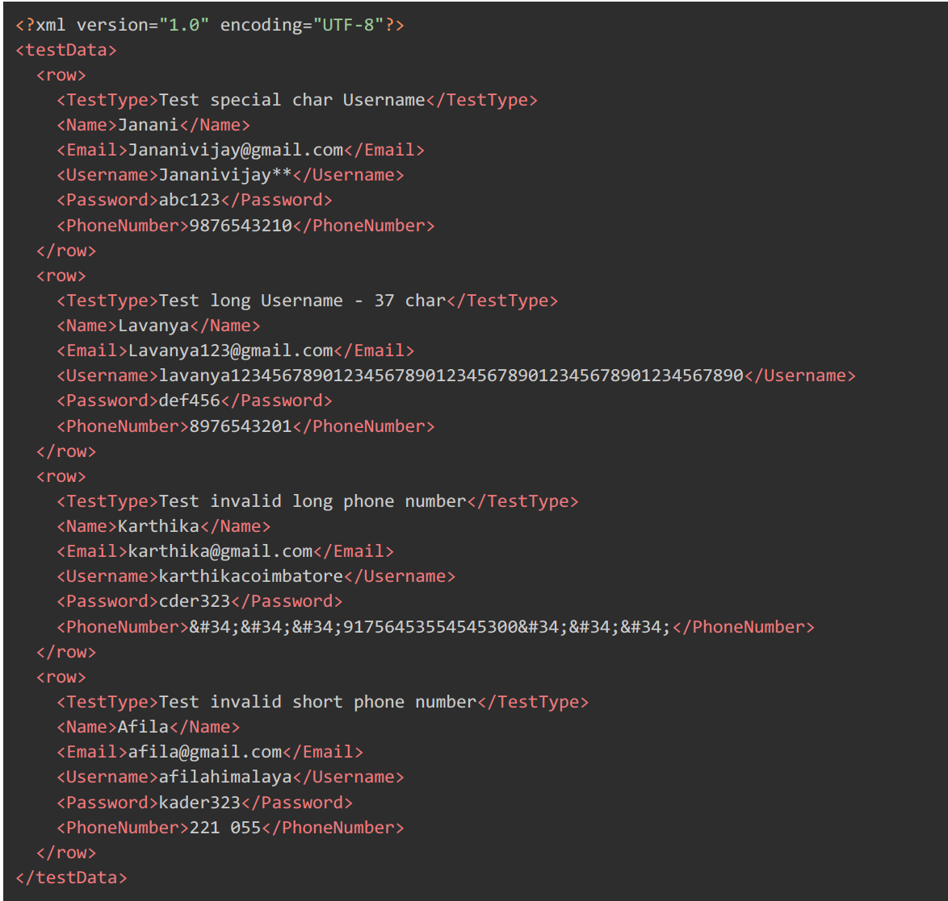
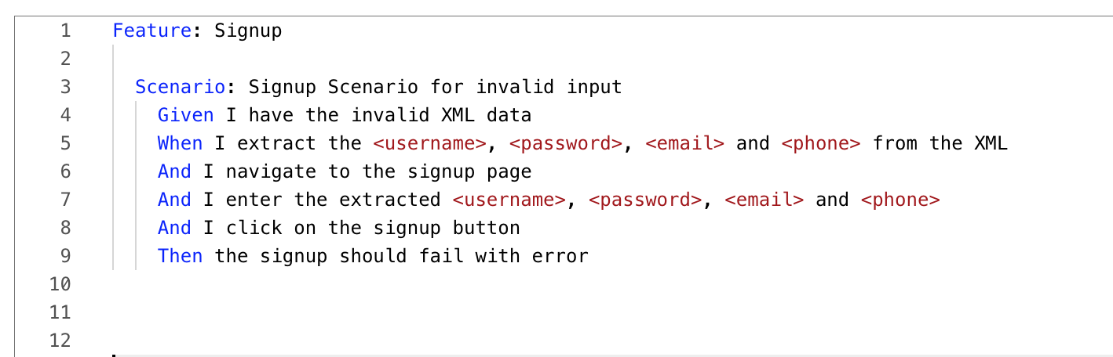
Cucumber- automation test script - Invalid scenario

Slide 24
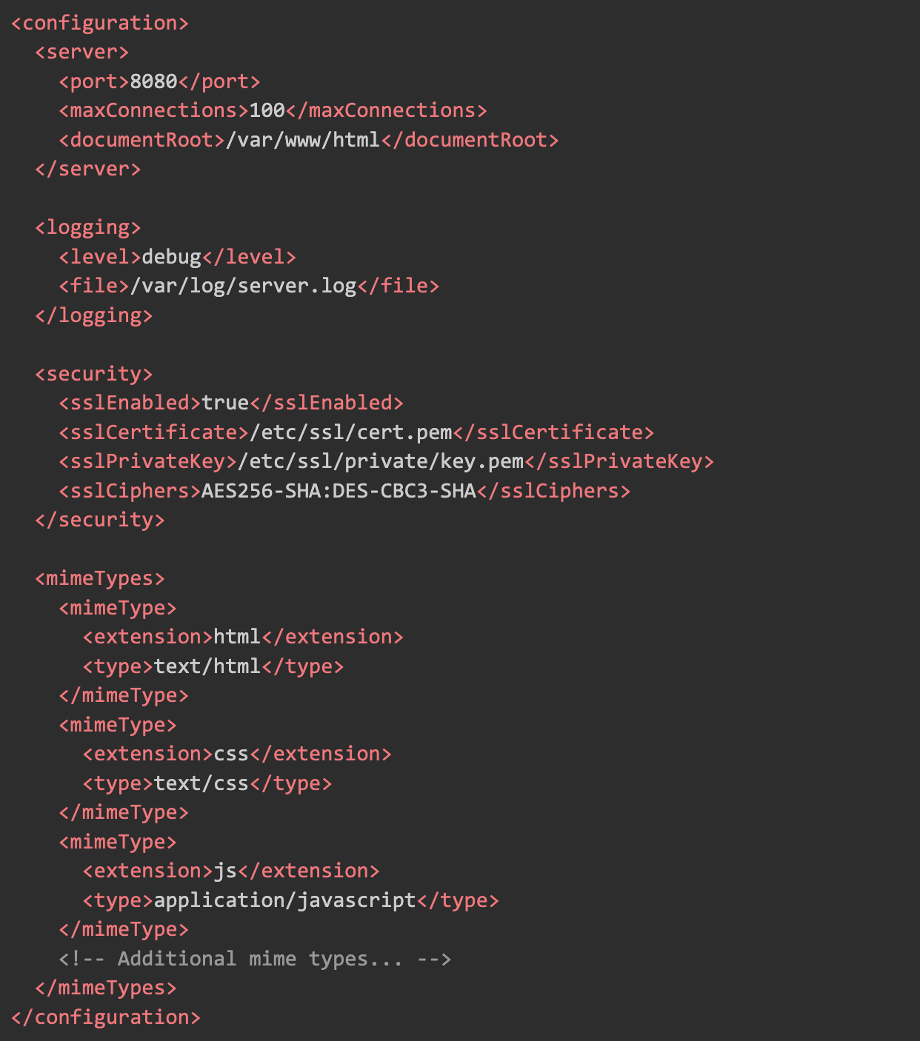

XML File – As Configuration file

Slide 25
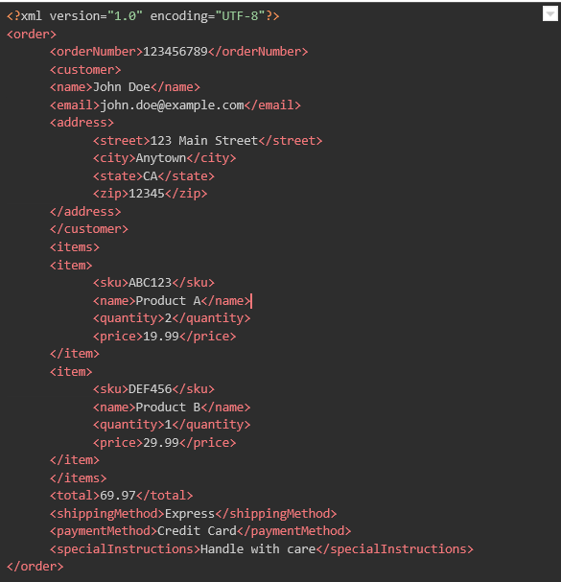

Exchanging data - XML format
The XML structure represents an order being exchanged between an e-commerce platform and a logistics provider.

Slide 26

Restful API - Postman
URL: https://api.example.com/data
Headers : {'Content-Type’- 'application/xml'}
Method: POST
Sample XML Request:
<request>
<name>John Doe</name>
<age>30</age>
<email>john.doe@example.com</email>
</request>

Slide 27


Slide 28


